Slide 1
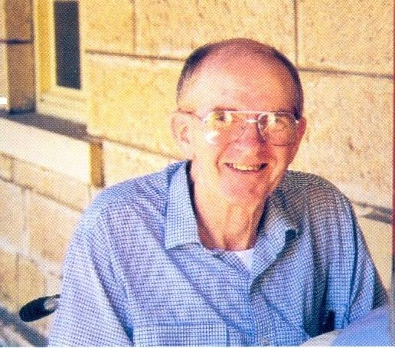
Pat Reynolds 26/3/1931 – 27/3/2001

Slide 2
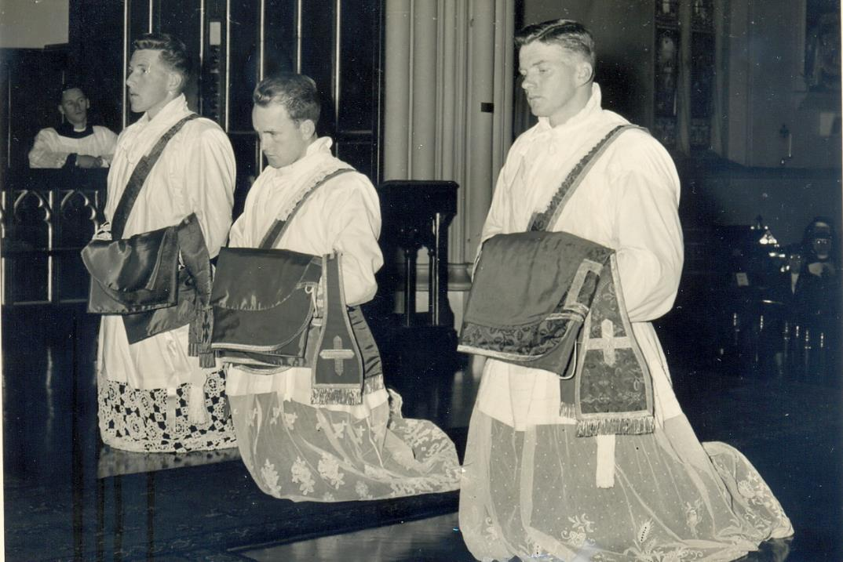

Slide 3
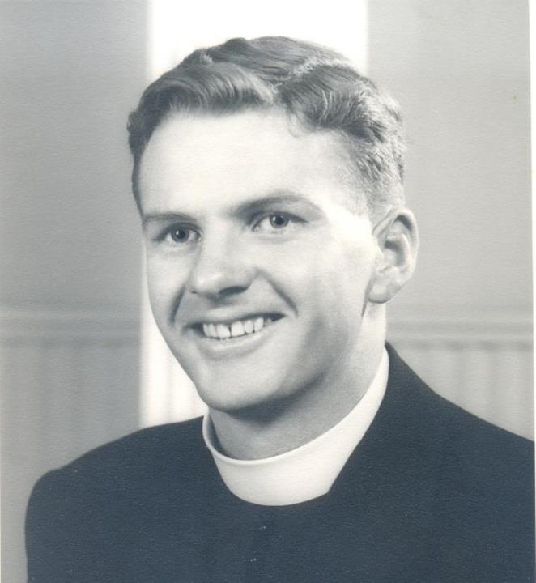

Slide 4
Pat Reynolds believed that commitment to the Society was a two-way process, and that each individual has the responsibility to forge links with his confreres and his province.
He lived this belief all his life.

Slide 5
Multiple Sclerosis
Pat taught at St John’s College in Lismore and Chanel College in Geelong after ordination. He was about to go on mission to Japan in 1960 when he realised something was wrong.
He was diagnosed with multiple sclerosis.
He could not go on mission to Japan.
He taught for a few years before taking up the role of bursar in the Marist Seminary from 1966 to 1985.

Slide 6
He continued to find ways of exercising pastoral ministry, and he adapted his life and his ministries as his mobility decreased.
Pat accepted his condition but he resisted the temptation to withdraw from Marist and community life.

Slide 7
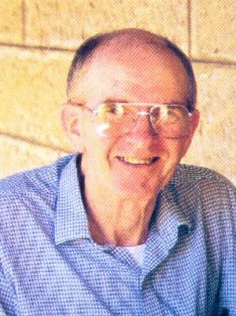

Slide 8
“It was clear to us that Pat didn’t look on the “Society of Mary” or the “Province” as some abstract idea.
They were people who were his brothers.
He welcomed visits but he didn’t wait for us to come to him.

Slide 9
“He moved out from the confinement of his MS - he embraced every type of technology – from his word-processor to his motorized wheelchair – in order to stay connected with his community and engaged in Mary’s work.”

Slide 10
“He was an inspiration to many in his deep faith, his cheerfulness and fortitude in the face of adversity, and in the total authenticity of his life.”

Slide 11
Pat was an inspiration to all who knew him.
Not long before he died he remarked:
“It’s all there in Jeremiah:
‘I have loved you with an everlasting love; therefore I have continued my faithfulness to you.’”
He could hardly have summed up his own life and spirituality more succinctly.

Slide 12
The preceding verse from Jeremiah: “The people who survived the sword found grace in the wilderness,” was not mentioned by Pat; it was not his way to mention his own pain and suffering.
For 40 years MS put him ‘in the wilderness’; he was sorely tested. But his amazing courage and quiet dignity enabled many others to ‘find grace’ through him.

Slide 13
Every Marist concerns himself with the community of the province to which he belongs or in which he works, and shares in the responsibility for its undertakings.
SM Constitutions N. 131

